Slide 1

Flight Price Trend & Demand Analysis
Web Scraping & Data Analysis using Python
Presented by-
Akshitha Yasala
Batch No. 493

Slide 2
AGENDA
Business Problem
Problem Statement
Data Collection Using Web Scraping from easemytrip.com
Data Preprocessing and Data Cleaning
Visualizations
Hypothesis Testing
Key Insights and Findings
Future Enhancements
Conclusion

Slide 3
BUSINESS PROBLEM
Customers face difficulty in predicting airline ticket prices because prices fluctuate dynamically based on demand and market conditions. There is no easy way to identify the best time to book affordable flights.
The business problem is to analyze flight pricing patterns and demand trends using scraped airline data to generate meaningful insights that support better travel planning and pricing decisions.

Slide 4
PROBLEM STATEMENT
This project aims to collect real-time flight data from EaseMyTrip through web scraping and analyze pricing trends, customer demand patterns, and airline fare behavior using data analytics techniques. The insights generated will help users make cost-effective travel decisions and understand market pricing strategies.

Slide 5

Data Collection Using WebScraping from EaseMyTrip Website
Collected real-time flight data from the EaseMyTrip website using Web Scraping techniques Extracted important attributes such as:
Airline Name
Source & Destination
Departure and Arrival Time
Flight Duration
Ticket Price
Travel Date
Used Python libraries:
Selenium
Regex
Pandas

Slide 6
Data Preprocessing and Data Cleaning
Checked dataset structure using:
.info()
.describe()
.isnull()
Handled missing values
Removed duplicate records
Converted columns into proper data types
Standardized text formatting
Performed feature engineering

Slide 7
Tools Used for EDA
Python
Pandas
NumPy
Matplotlib
Seaborn
Jupyter Notebook
The EDA process helped uncover meaningful pricing trends, airline fare patterns, and route-based demand insights from the scraped EaseMyTrip dataset. The analysis provided a strong foundation for business understanding and future predictive modeling.

Slide 8
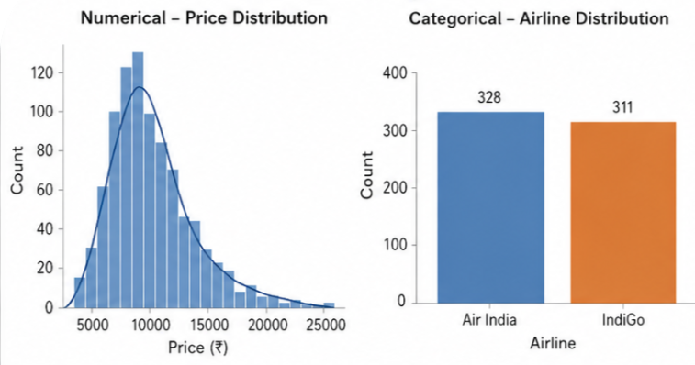
DataVisualization
Univariate Analysis
Price Distribution (Histogram)
Most ticket prices are concentrated in the lower price range.
Price distribution is positively skewed.
Few high-price outliers are present.
Airline Distribution (Countplot)
Air India and IndiGo dominate the dataset.
Flight frequency is almost evenly distributed.

Slide 9
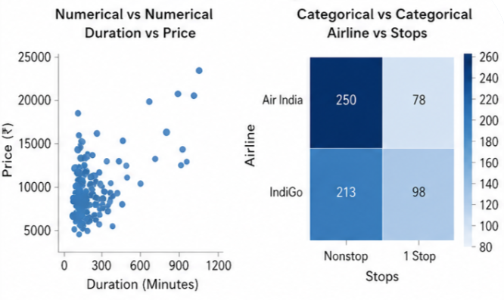
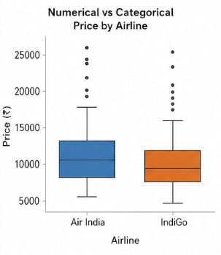
DataVisualization
Bivariate Analysis
Duration vs Price (Scatter Plot)
Ticket price generally increases with flight duration.
Longer flights tend to have premium pricing.
Airline vs Stops (Heatmap)
Most flights are nonstop.
1-stop flights are comparatively fewer.
Price by Airline (Boxplot)
Air India shows wider price variation.
IndiGo has comparatively stable pricing.

Slide 10
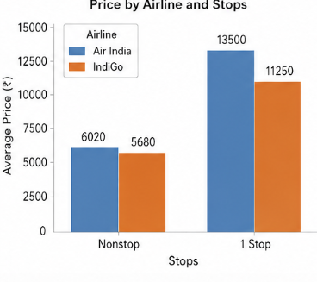
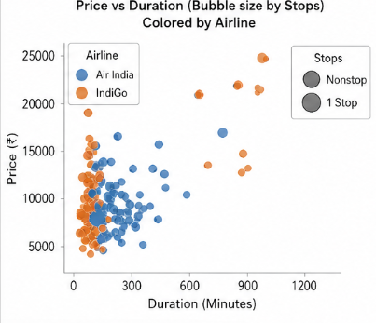
DataVisualization
Multivariate Analysis
Price vs Duration by Airline and Stops
Longer duration flights with stops show higher prices.
Airline type influences fare distribution.
Nonstop flights are concentrated in lower duration ranges.

Slide 11
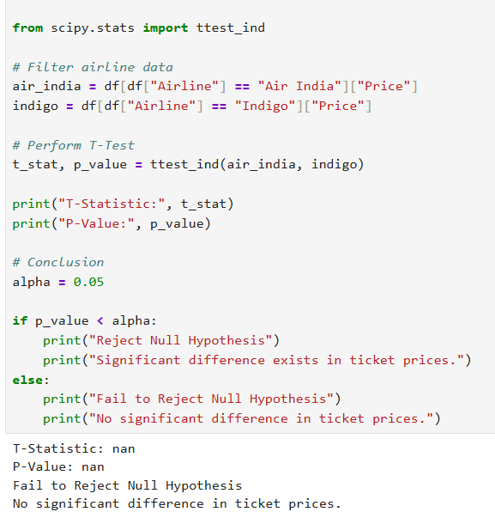
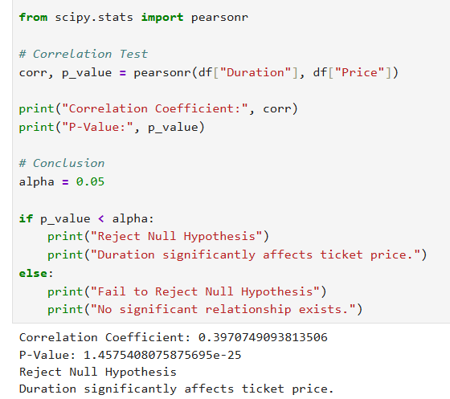
Hypothesis Testing
Question 1
Is there a price difference between Air India and IndiGo?
Null Hypothesis (H₀)
No significant difference in ticket prices.
Alternate Hypothesis (H₁)
Significant difference exists.
Condition
p-value < 0.05
Conclusion
Fail to Reject H₀ if p-value < 0.05.
Question 2
Does flight duration affect ticket price?
Null Hypothesis (H₀)
No relationship between duration and price.
Alternate Hypothesis (H₁)
Significant relationship exists.
Condition
p-value < 0.05
Conclusion
Reject H₀ if p-value < 0.05.

Slide 12
Business Insights
Air India and IndiGo dominated the flight market.
Longer flights generally had higher ticket prices.
Nonstop flights were more frequent.
Some routes showed premium pricing trends.
Ticket prices varied dynamically across airlines and routes.
High-price outliers indicated premium or last-minute bookings.

Slide 13
Future Enhancements
Integrate real-time flight data collection for continuous fare monitoring.
Expand the dataset by including travel dates, seat availability, and airline ratings.
Develop predictive models for flight price forecasting using Machine Learning.
Build interactive dashboards using Power BI or Tableau for business reporting.
Automate the web scraping pipeline for large-scale data collection and analysis.
Enhance feature engineering with seasonal and demand-based pricing analysis.

Slide 14
Conclusion
Successfully scraped and analyzed flight fare data from EaseMyTrip.
Performed data cleaning, preprocessing, and feature engineering.
Identified pricing trends across airlines, routes, and flight durations.
Observed dynamic pricing behavior in ticket fares.
Generated meaningful business insights using EDA and visualizations.
Prepared cleaned data for dashboard development and business analysis.

Slide 15


Slide 16


